Slide 1
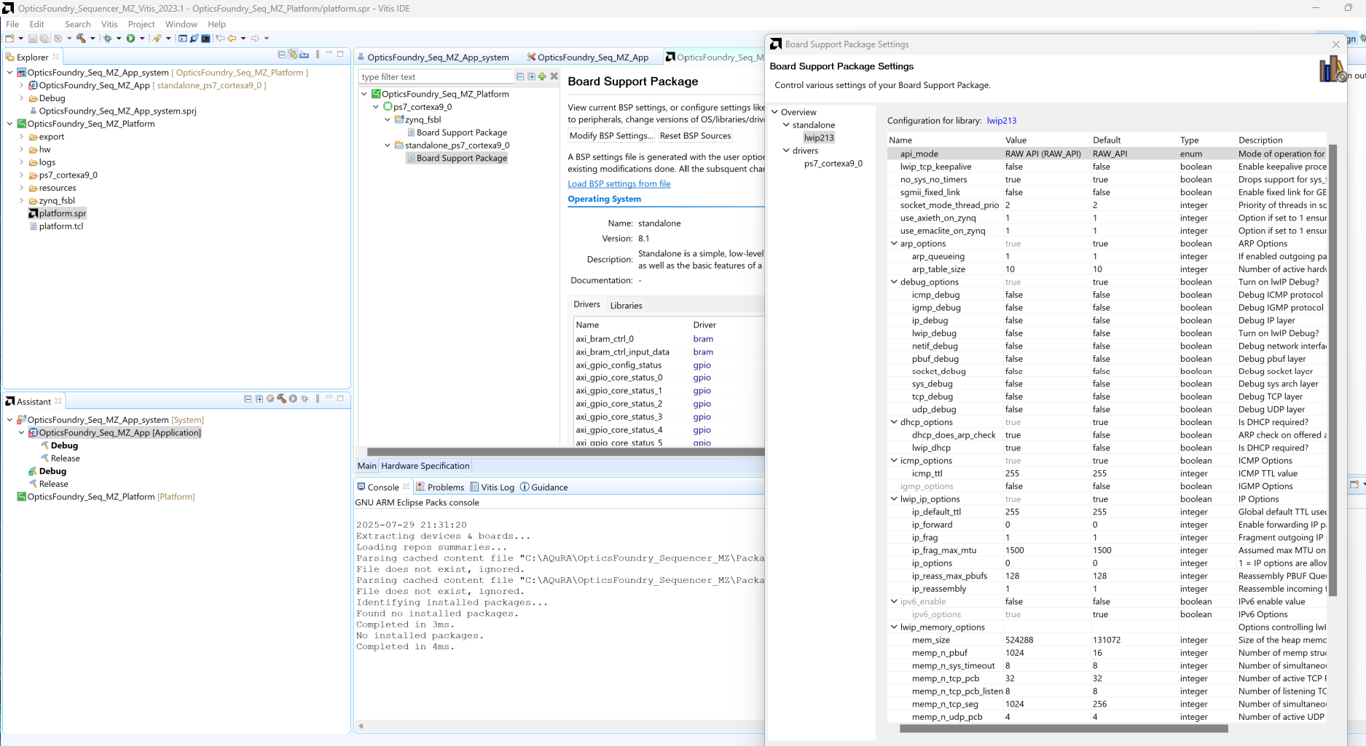

Slide 2
To switch between static IP and DCHP: in lwipopts.h (appears twice in project, search for “#define LWIP_DHCP” in whole project with Visual Studio Code) DHCP: #define LWIP_DHCP 1 #define DHCP_DOES_ARP_CHECK 1 StaticIP: #define LWIP_DHCP 0 #define DHCP_DOES_ARP_CHECK 0

Slide 3
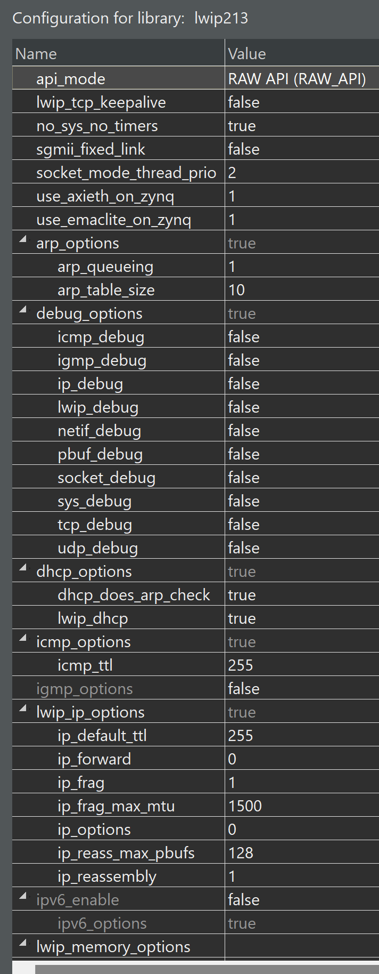
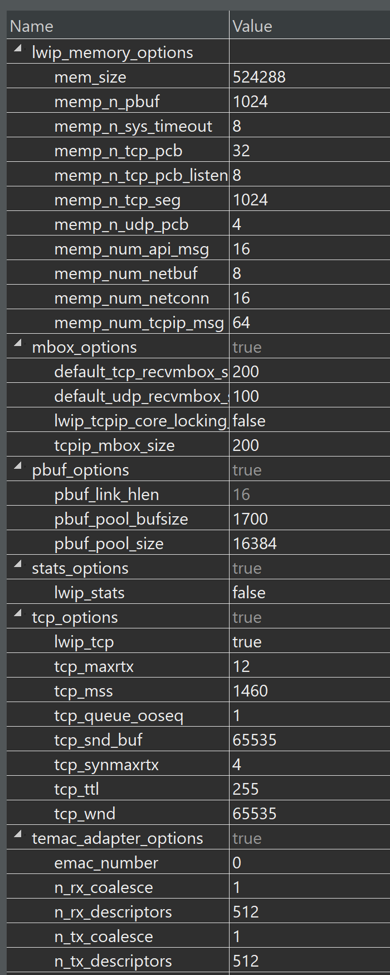
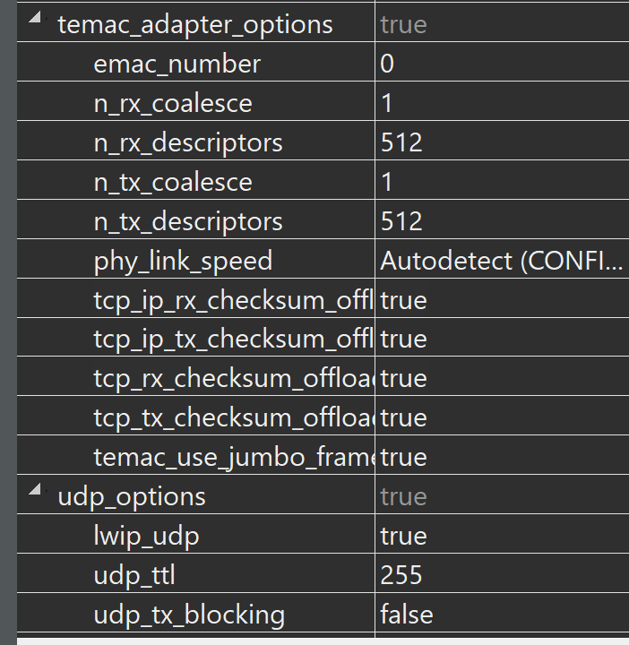
working

Slide 4
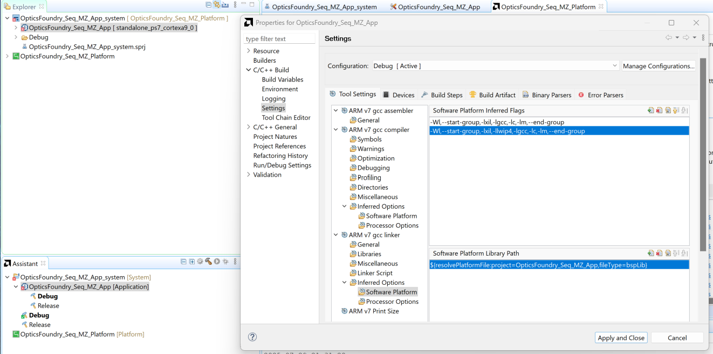
Other settings: to enable math functions: Software Platform Inferred Flags -Wl,--start-group,-lxil,-lgcc,-lc,-lm,--end-group -Wl,--start-group,-lxil,-llwip4,-lgcc,-lc,-lm,--end-group

Slide 5
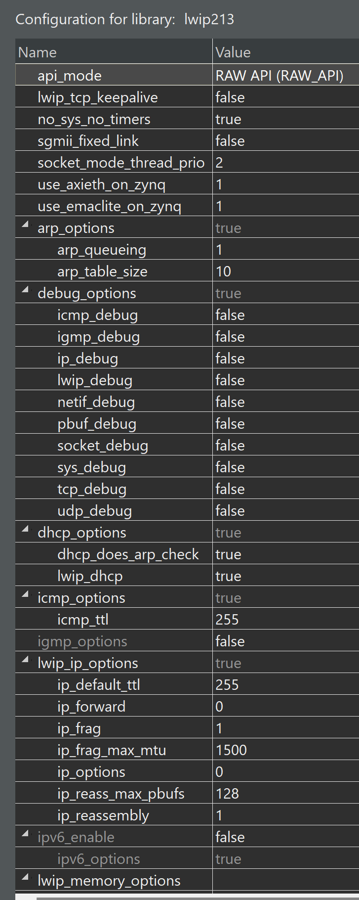
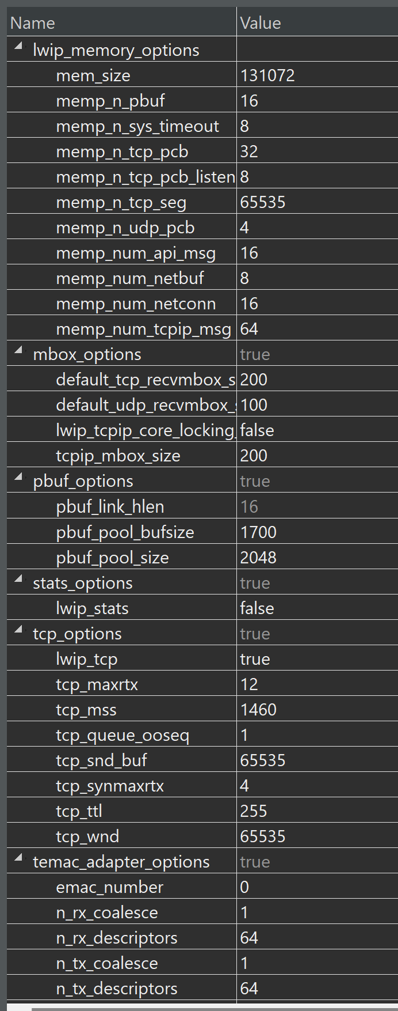

working
Not working
(maybe because of missing second AXI interconnect)

Slide 6
Working new

Slide 7
Working new

Slide 8
Working new

